Slide 1
Data Models & Types of Database System

Slide 2
Types of Data models
Physical Data Models
Hierarchical Data Model
Network Data Model
Relation Data Model
Entity – Relationship (E-R) Data Model
Object – oriented Data Model

Slide 3
Physical Data Models
A physical data model is a database-specific model that represents relational data objects (for example, tables, columns, primary and foreign keys) and their relationships.

Slide 4
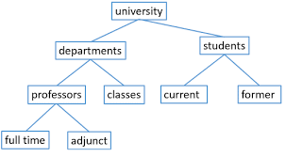
Hierarchical Model
was the first database management system model.
This concept uses a hierarchical tree structure to organise the data.
The hierarchy begins at the root, which contains root data, and then grows into a tree as child nodes are added to the parent node.

Slide 5

Network model
The Network Model in DBMS is a hierarchical model that is used to represent the many-to-many relationship among the database constraints.

Slide 6
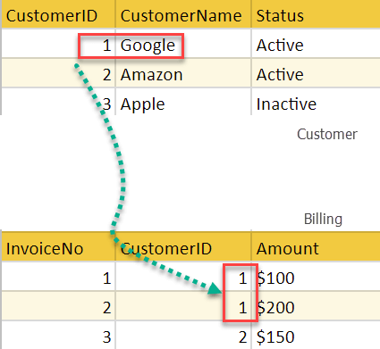
Relational Model
The relational model in DBMS is an abstract model used to organize and manage the data stored in a database.
It stores data in two-dimensional inter-related tables, also known as relations in which each row represents an entity and each column represents the properties of the entity.

Slide 7
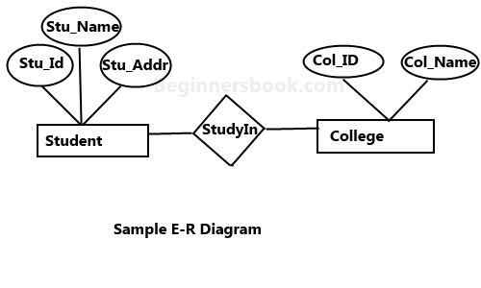
E R model
ER model stands for an Entity-Relationship model.
It is a high-level data model.
This model is used to define the data elements and relationship for a specified system.
It develops a conceptual design for the database.

Slide 8
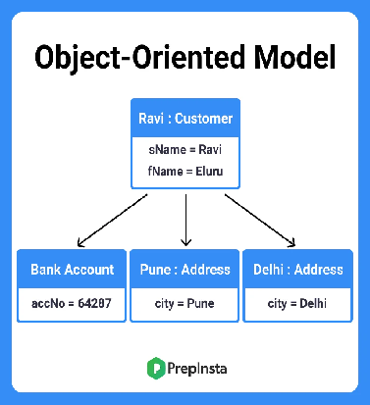
Object – oriented Data Model
The ODBMS which is an abbreviation for object-oriented database management system is the data model in which data is stored in form of objects, which are instances of classes.

